Slide 1





ECS Student workshop
An introduction to R programming for cetacean data analysis
Miguel Martins (CEAUL, AIMM); Moritz Klaassen (MARE); Catarina T. Fonseca (OKEANOS)
Third session

Slide 2
Goals
Import and summarise a presence/absence dataset
Map presences and absences in space
Fit, summarise, interpret and project a presence-absence GLM
Fit, summarise, interpret and project a presence-absence GAM

Slide 3
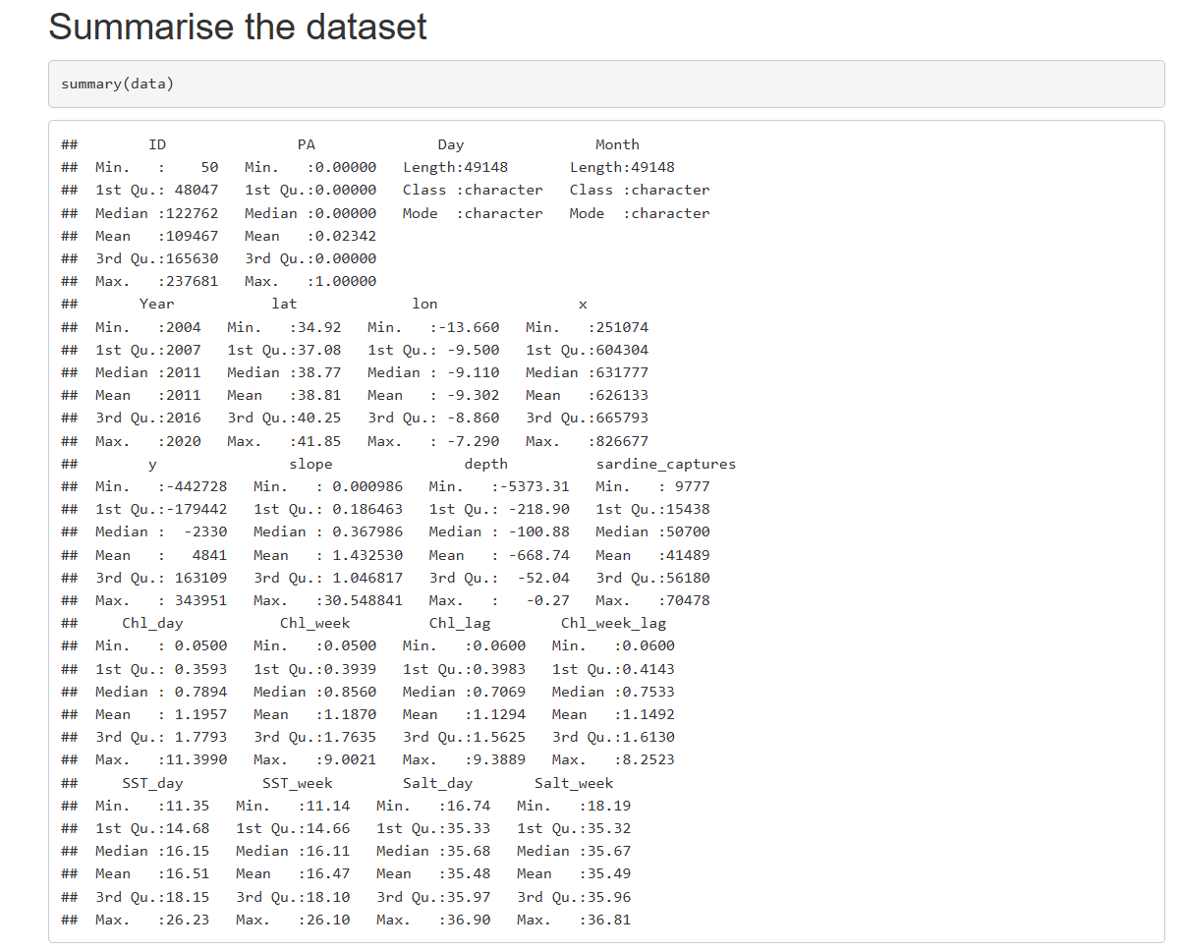
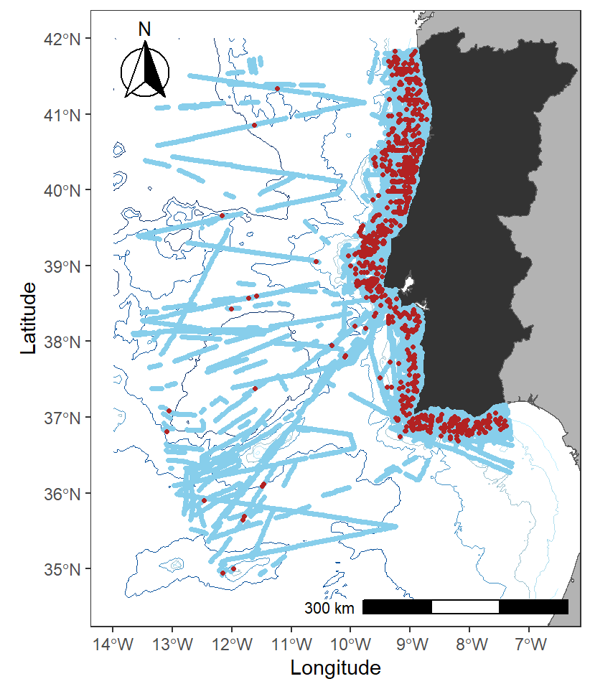
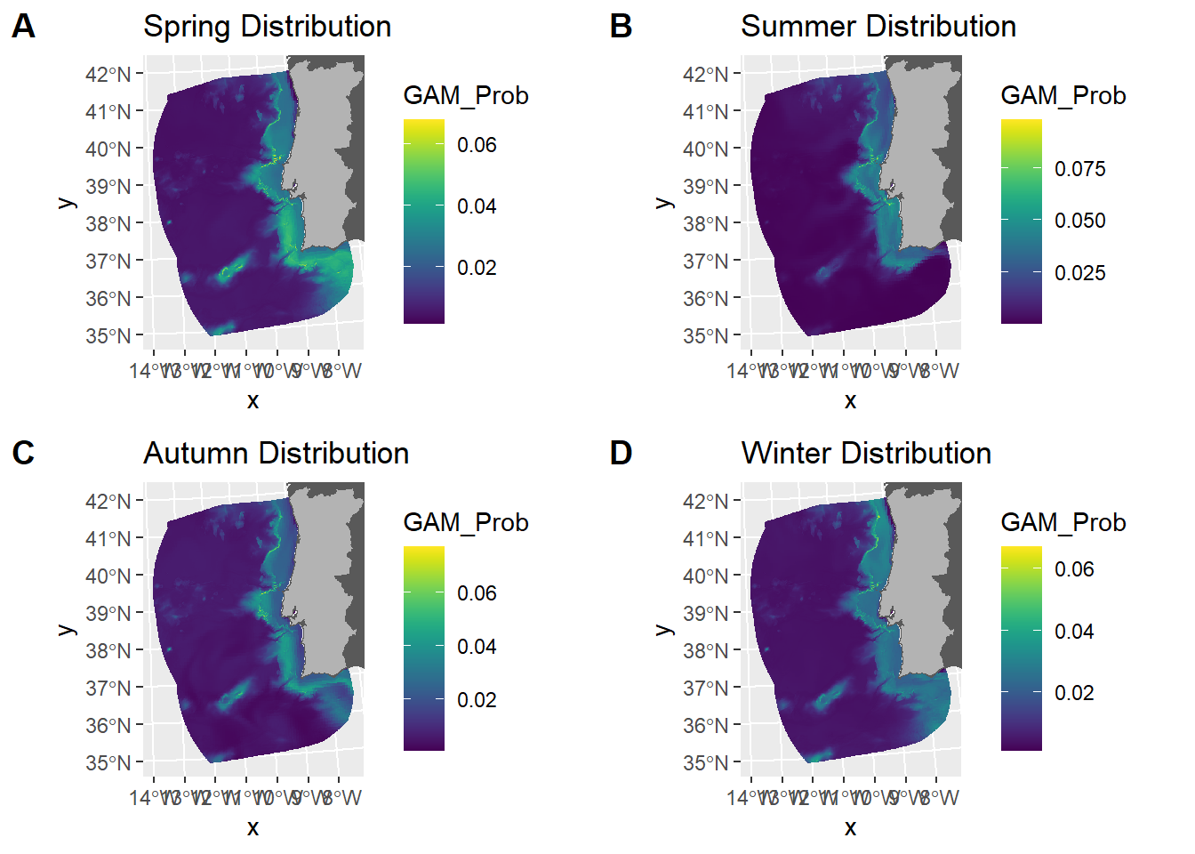
In essence

Slide 4
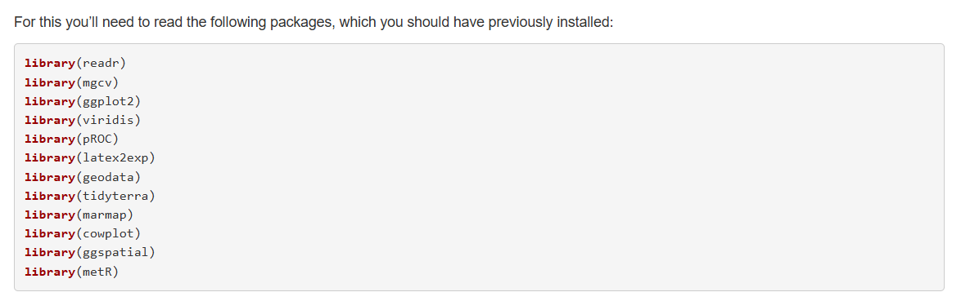
Let’s start by loading the packages

Slide 5
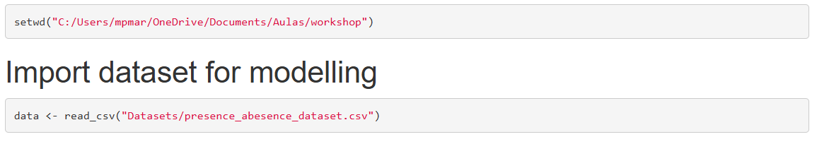
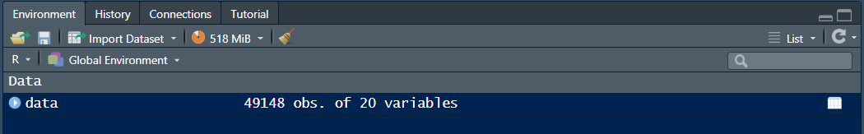
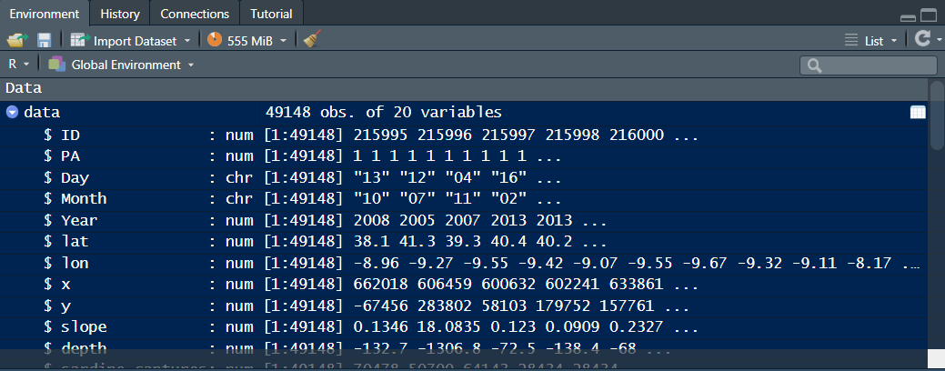
Read the data in
Write the path to the folder where you are working
Use this to create your new object called data, for your… data ☺
The read_csv function is used to read .csv files into R. Call the file based on the directory you are working in

Slide 6
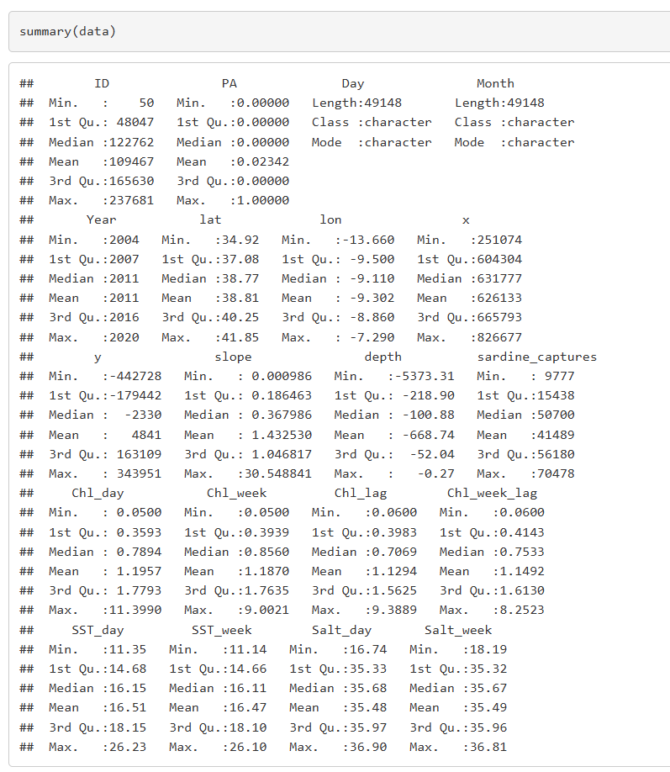
Making a summary of our data

Slide 7
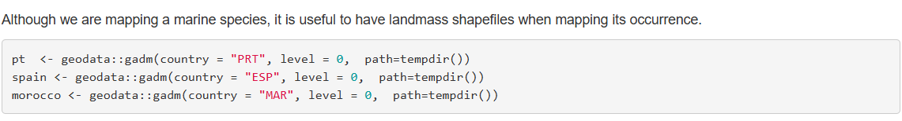
Mapping our observations – Downloading shapefiles
The gadm function of the geodata package downloads shapefiles of countries, depending on the three-letter code you give in the argument country.
Setting the level argument to 0 gives you a file of the country only. Increasing it will create more subdivisions within the country, marking important political regions.
The path argument is set as a temporary directory. This will result in not downloading the shapefiles anywhere in your PC. It can be useful to download the files, though, so you can give it a directory to keep the shapefiles with you.

Slide 8
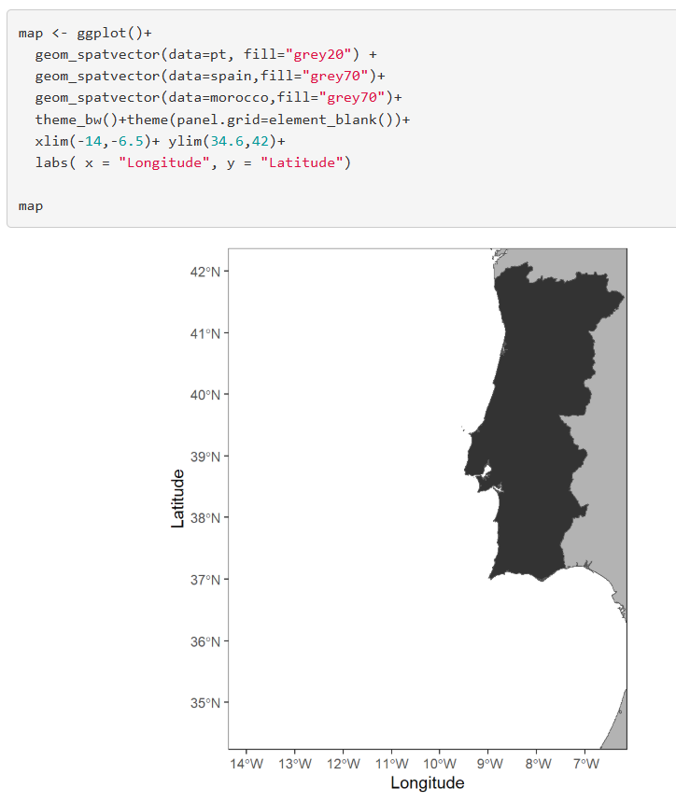
Mapping our observations – Mapping shapefiles
We are starting by creating an object named map
Then, we call the ggplot function with a + next to it. This means that we are using ggplot to plot something and we are going to add layers. Each + means we are adding a layer. To make things easier to read, after each + press enter to change line.
The geom_spatvector function serves to plot spatvector objects, which is the class of our shapefiles, using ggplot.
theme_bw()+theme(panel.grid = element_blank()) set the background to white.
xlim and ylim will set the x and y axis limits in your map.
The labs function seves to label the axis in our map, we need to give a string for the x and the y axis separately.
Call your map object and you should obtain the map in the slides

Slide 9
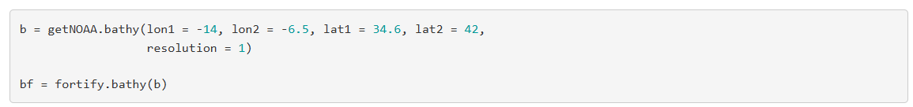
Mapping our observations – Downloading bathymetry data
The first bit of code serves to download bathymetry data from NOAA.
You need to give it a range of longitudes and latitudes, and a resolutions, the lower the value, the better the resolution will be.
This gives you a dataframe object.
We then use the fortify.bathy function to make the object useful for plotting.

Slide 10
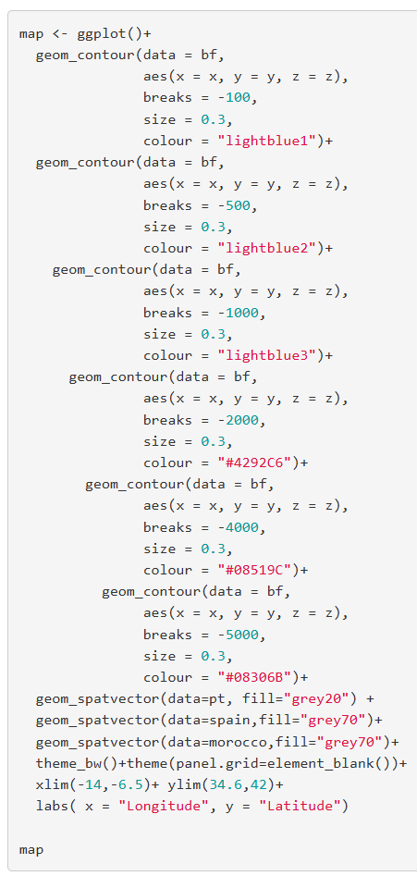
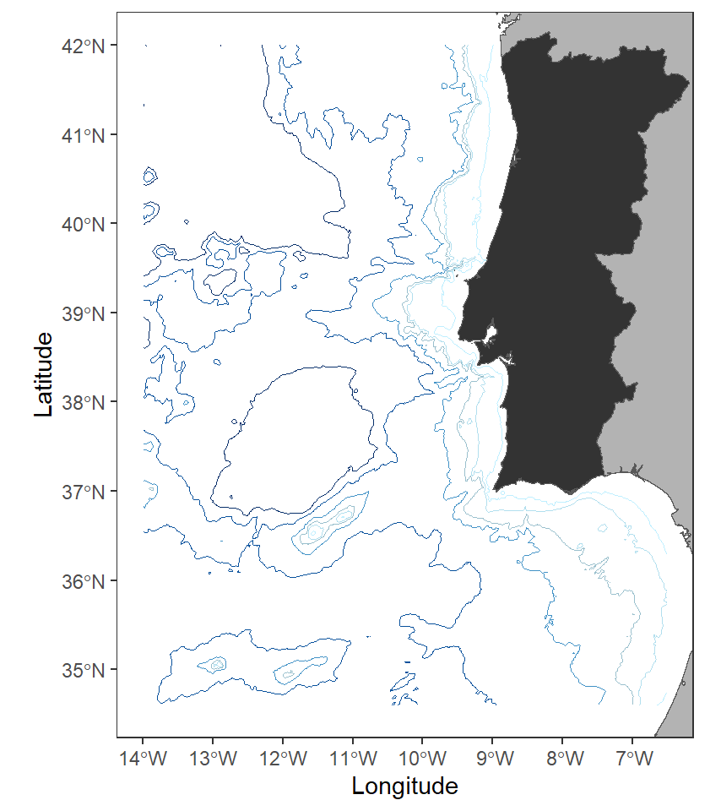
Mapping our observations – Adding isobathymetric lines

Slide 11
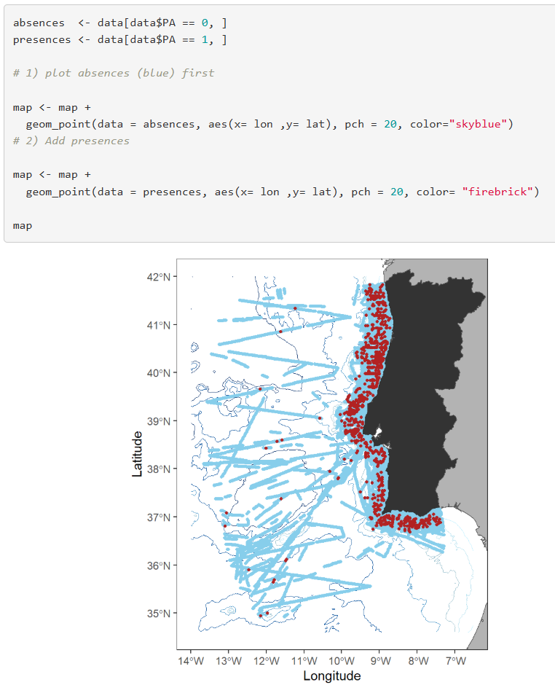
Mapping our observations
We can finally add our observations into our map!
To distinguish our presences from the absences, let’s create datasets for each. Alternatively you could use the subset function:
absences <- subset(data, data$PA ==0)
presences <- subset(data, data$PA ==1)
We then add to our map object the points for the absences and then for the presences, so that the presences are on top of the absences.
Use different colours to distinguish the two. Additionally, you can change the point size.

Slide 12
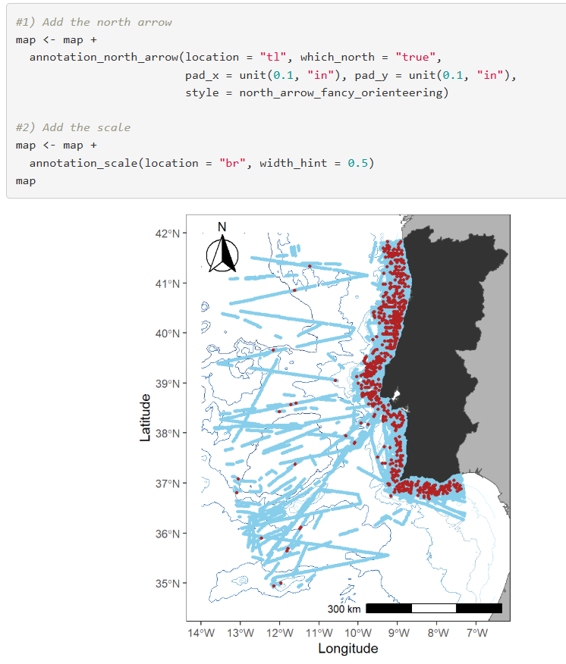
Mapping our observations – Adding north arrow and scale
It is important to have a north arrow and a scale in our maps.
Let’s use the annotation_north_arrow function. The location argument says “tl” which stands for top left. “tr” would be top right, “br” bottom right and “bl” bottom left.
The which_north argument is set to true to give us the true north instead of the magnetic north. The pad_x and pad_y arguments push the arrow a bit to the side. You can change the style of the north arrow. Run ?annotation_north_arrow to see the available styles.
The annotation_scale function gives us the scale. The location argument works the same as with the annotation_north_arrow function. The width_hint argument tells you how much space of the map will your scale occupy. If your map is in lat long coordinates you don’t have to specify units. But if it’s in another scale, for example, x and y coordinates with meters being the units, you have to specify it.

Slide 13
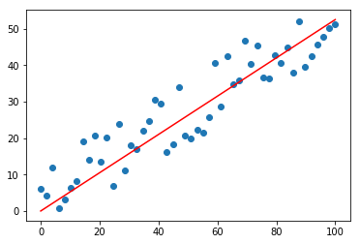
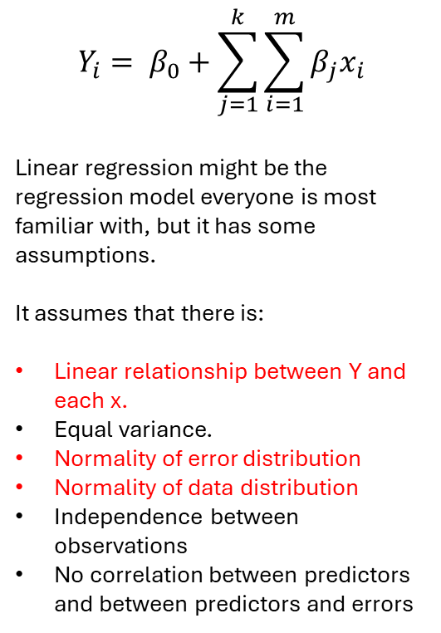
Regression models
$$Y_{i}= β_{0}+\sum_{j=1}^{k}{\sum_{i=1}^{m}{β_{j}x_{i}}}$$
Linear regression might be the regression model everyone is most familiar with, but it has some assumptions.
It assumes that there is:
Linear relationship between Y and each x.
Equal variance.
Normality of error distribution
Normality of data distribution
Independence between observations
No correlation between predictors and between predictors and errors

Slide 14
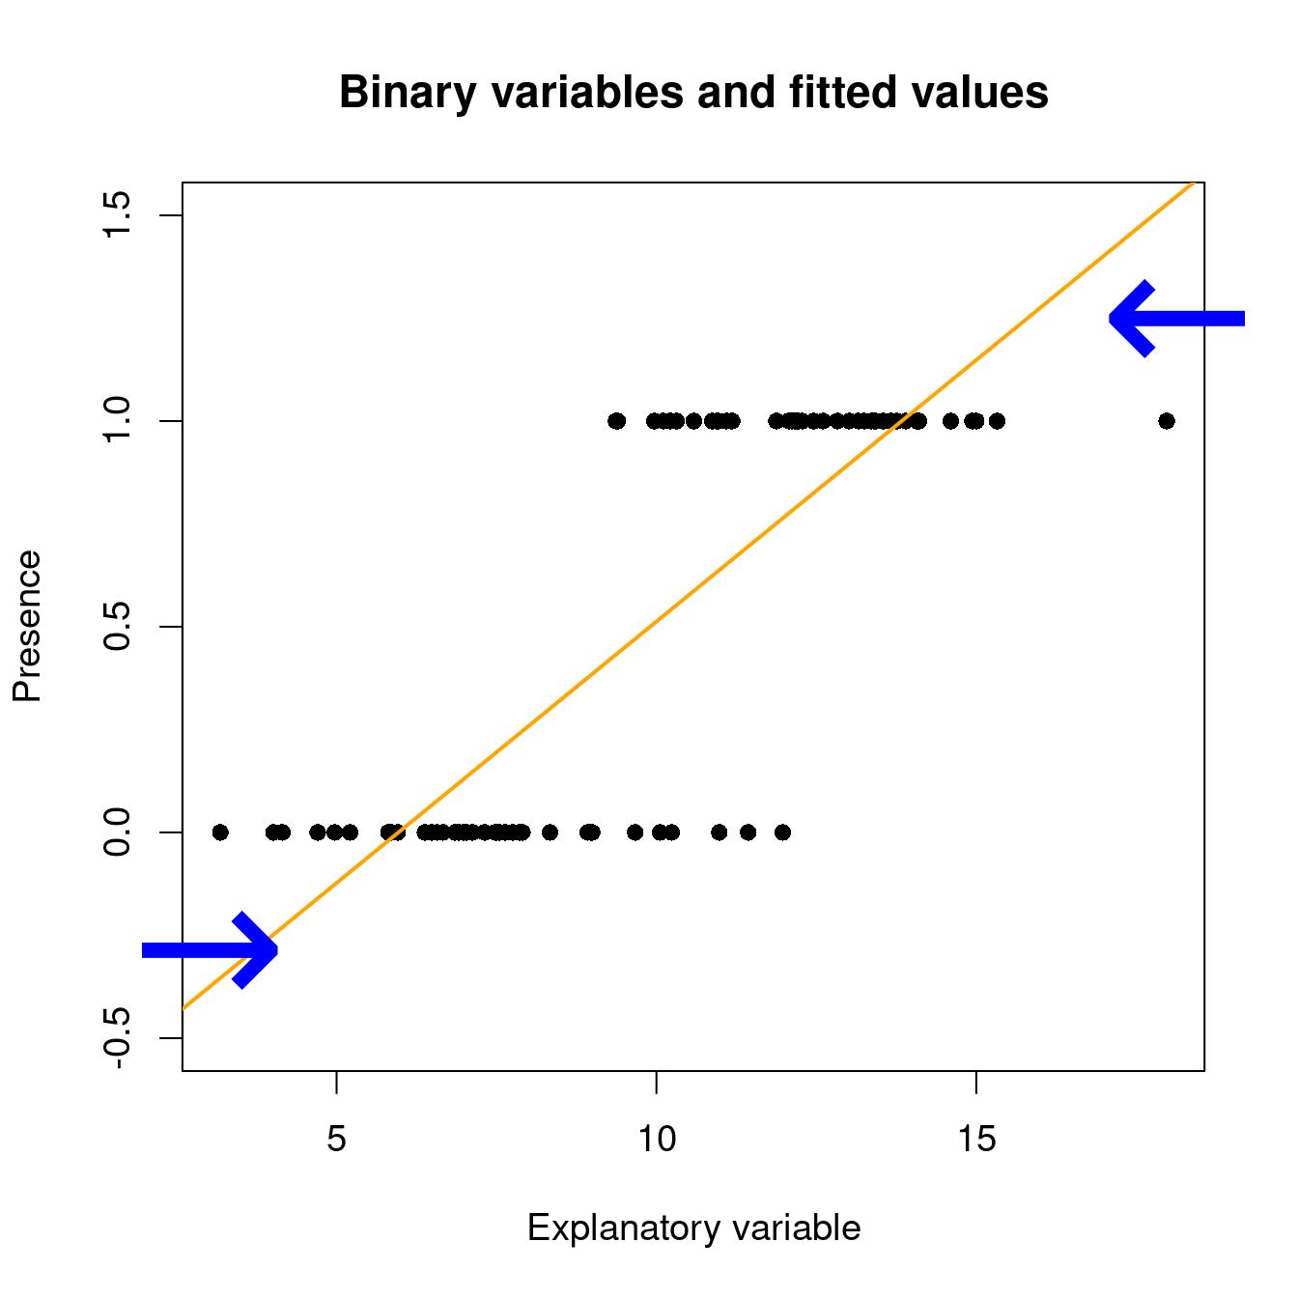
One solution: Generalized Linear Models (GLMs)
Our data is NOT normally distributed. We have 1’s (presences) and 0’s (absences). To model this data one could use the Binomial distribution, with Y ~ Bin (n, p), where Y is the presence of a dolphin, n is the number of observations (presences and absences included) we have and p is the probability of presence.
If we used Linear regression, it would look something like this:
The line predicts negative values, and values over 1. So, it doesn’t predict probabilities.
We want to constrain the predicted values between 0 and 1.
We can use GLMs for that. As the name suggests, GLMs are generalizations of linear models
They can deal with non-normal data and don’t assume a distribution for the residuals
They work by transforming our response variable using a link function and then fitting a linear model through that.
We can then use the model to predict results in the response variable’s scale

Slide 15
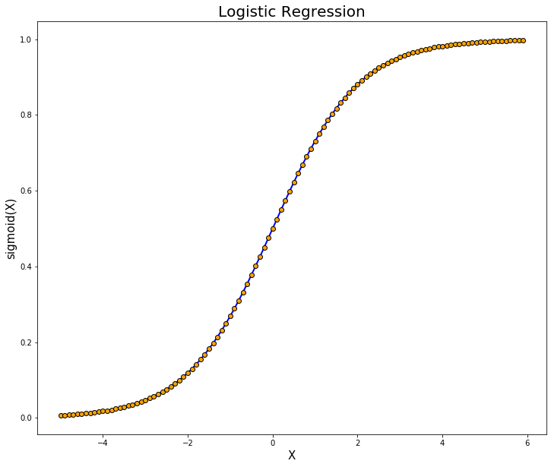
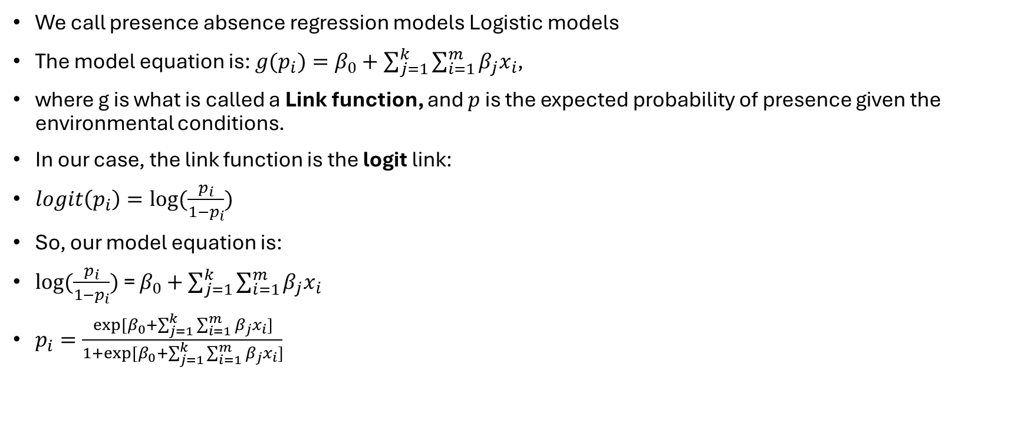
GLMs – Logistic Regression
We call presence absence regression models Logistic models
The model equation is: $g(p_{i})=β_{0}+\sum_{j=1}^{k}{\sum_{i=1}^{m}{β_{j}x_{i}}}$,
where g is what is called a Link function, and $p$ is the expected probability of presence given the environmental conditions.
In our case, the link function is the logit link:
$logit\left(p_{i}\right)=log⁡(\frac{p_{i}}{1−p_{i}})$
So, our model equation is:
$log⁡(\frac{p_{i}}{1−p_{i}})$ = $β_{0}+\sum_{j=1}^{k}{\sum_{i=1}^{m}{β_{j}x_{i}}}$
$p_{i}=\frac{exp⁡[β_{0}+\sum_{j=1}^{k}{\sum_{i=1}^{m}{β_{j}x_{i}}}]}{1+exp⁡[β_{0}+\sum_{j=1}^{k}{\sum_{i=1}^{m}{β_{j}x_{i}}}]}$

Slide 16
Miguel, shut up with stats!!! Let’s code the GLM
Start by creating a new object for our model. Since I’m super original, let’s call it glm1.
Since the guys who make R are equally original as I am, we will use the glm R function to create our GLM.
Start by giving the model’s formula using the formula argument. The notation should be:
Response variable ~ Explanatory variable1 + Explanatory variable 2 + … + Explanatory variable3
This means that we have the response variable as a function of the following explanatory variables. While we are not covering variable interactions here, if you want to have to Explanatory variables interacting with each other, the notation is, for example: Explanatory variable1*Explanatory variable2.
We use the argument data to tell our model where to get its data from.
Then we specify the family the data follows and the corresponding link function.

Slide 17
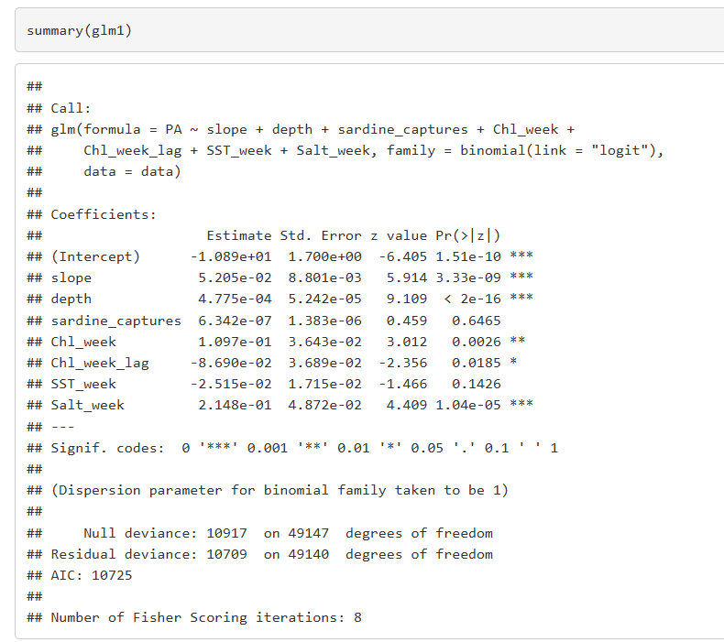
Seeing and interpreting the GLM output
Run a summary of our GLM.
The summary gives you the code you specified for the model.
The Estimate gives you the estimated coefficients for the model equation. Don’t bother with the intercept. For the variables, if the value is positive, this means that there is a positive relationship between the presence probability and that variable. If the value is negative, that means there is a negative relationship.
The Pr(>|z|) gives you the p-value associated to the effect of the variable. If we admit the typical significance level of 95%, then variables with a p-value higher than 0.05 may be considered as not having an effect on the dolphin presence probability.
The AIC is a metric you can use for model selection that balances the model’s explanatory power with its complexity. Lower AIC scores, typically, indicate better models. We generally admit that a model is significantly better than the other if the AIC score is lower by at least 2 units. However, AIC should not be used alone to select your final model. Consider other metrics like AUC, variance explained, etc.
We are not going to go in depth into model selection in this workshop.

Slide 18
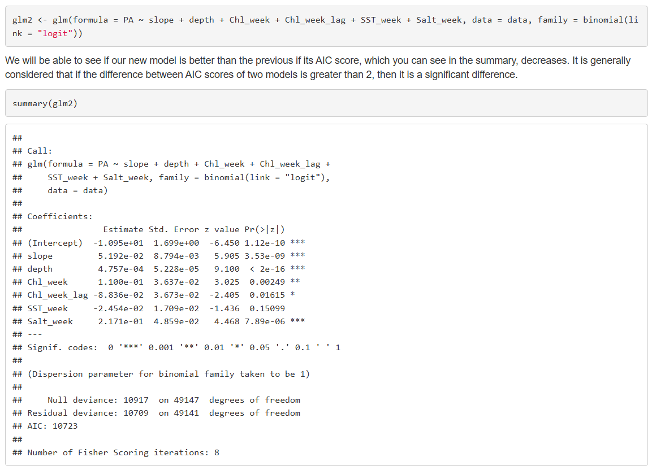
Let’s try and remove one variable
We have now removed biomass as a candidate explanatory variable from our model.
The AIC is now 10723, two units lower than previously, so we could say that this model is significantly better than the other.
Remember we would need to see other metrics to confidently choose between models, but for now let’s keep working with this one.

Slide 19
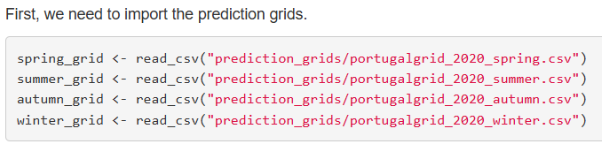
Model predictions
To predict the model results in space and time we need to import our prediction grids. These are data frame objects. Each row corresponds to one location and has information regarding the environmental conditions for all variables you used for modelling. If one is missing, then the model won’t be able to make predictions. In this case, each row corresponds to a square of 1 km² of area.
They should be created separately. We are not going over this in the workshop, unfortunately.
Let’s start with our spring prediction grid. This grid has the environmental conditions in each square for the midpoint of spring in 2020.
We create a new column in the data frame for our prediction. To predict, we use the predict.glm function. We have to give our glm object, in other words, the name of our model. The newdata argument is the data set we want to make predictions to, our prediction grid. The type argument is asking what is the scale of the prediction you want. In our case we are setting it to the response scale so that we obtain the presence probability.

Slide 20
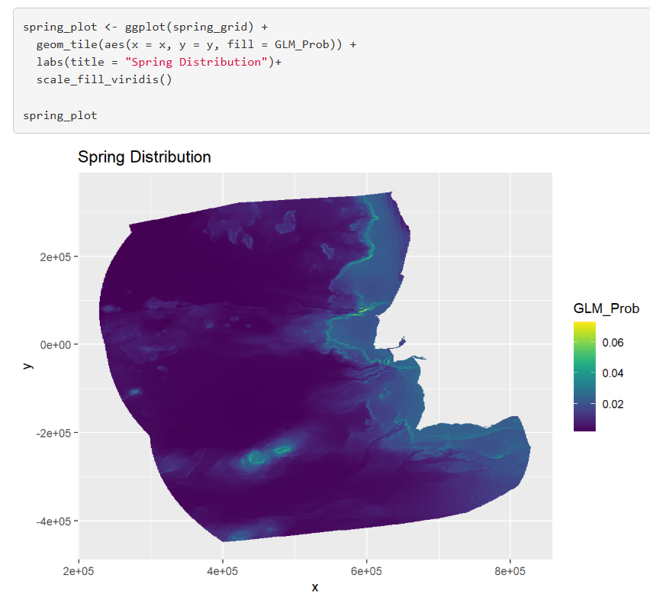
Plot model predictions with ggplot
We are calling again the ggplot function, with the spring_grid being our data.
The geom_tile function creates squares with a fill that you choose. In our case, the fill should be the predictions. If the squares aren’t all the same size, then this won’t work.
The scale_fill_viridis function creates the colour gradient you see in the plot. It comes from the viridis package, which is a colourblind friendly package.
This map would benefit from having land plotted alongside it, so we could have a better understanding of what we are looking at. So, let’s do it!

Slide 21
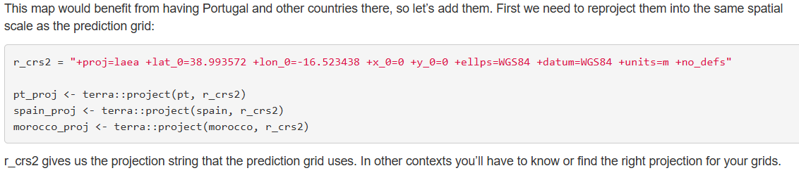
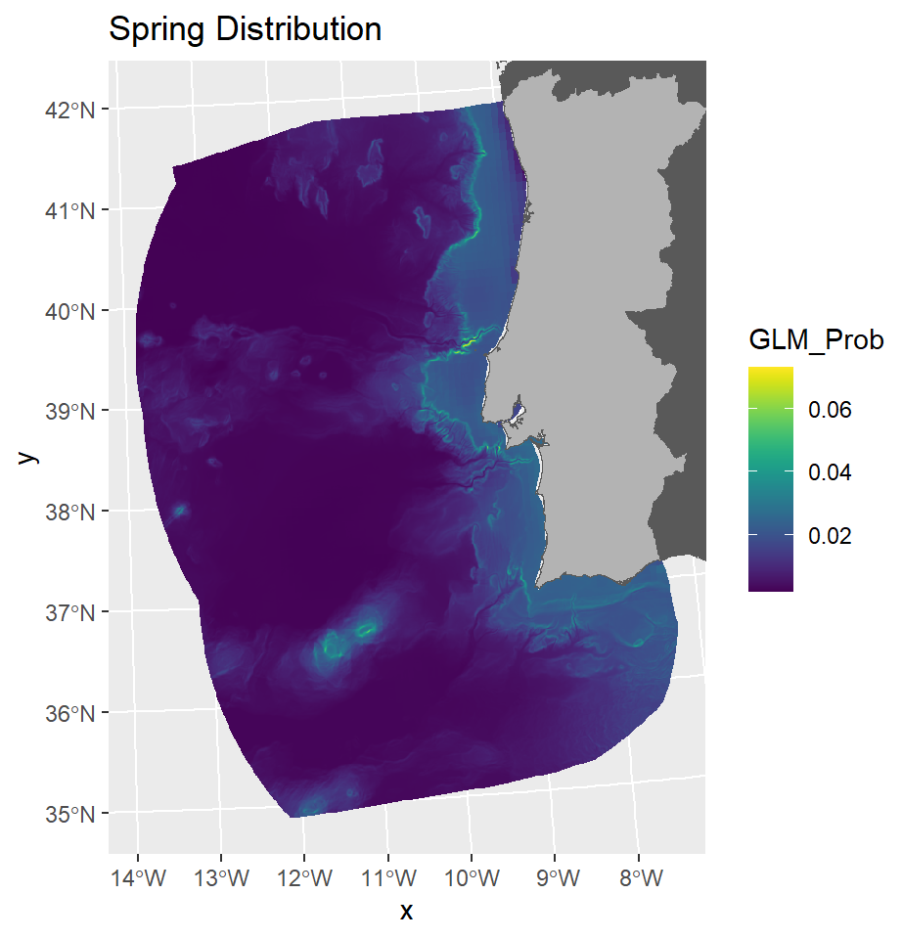
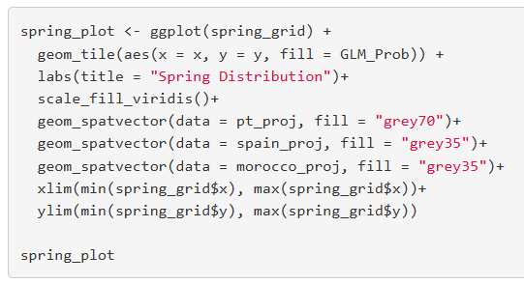
Improving prediction map

Slide 22
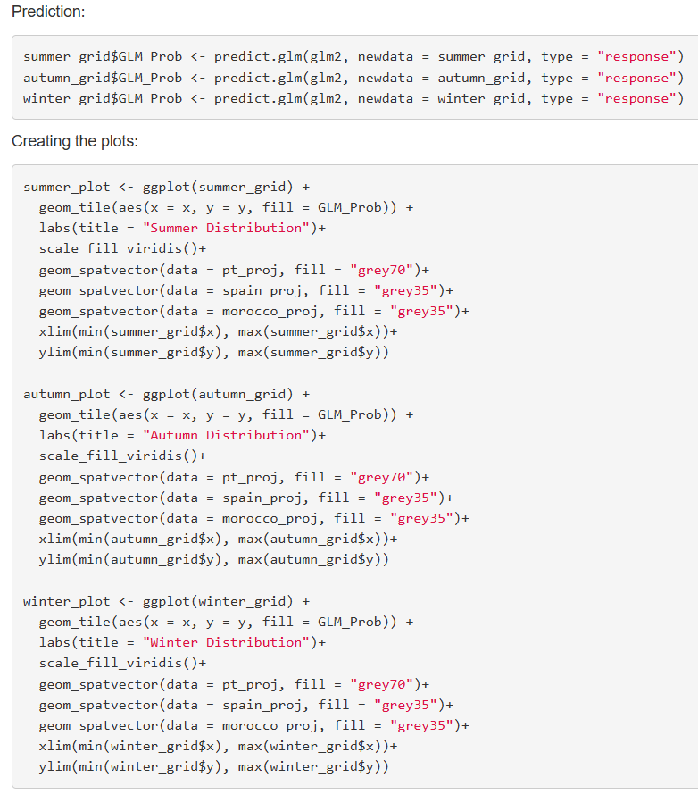
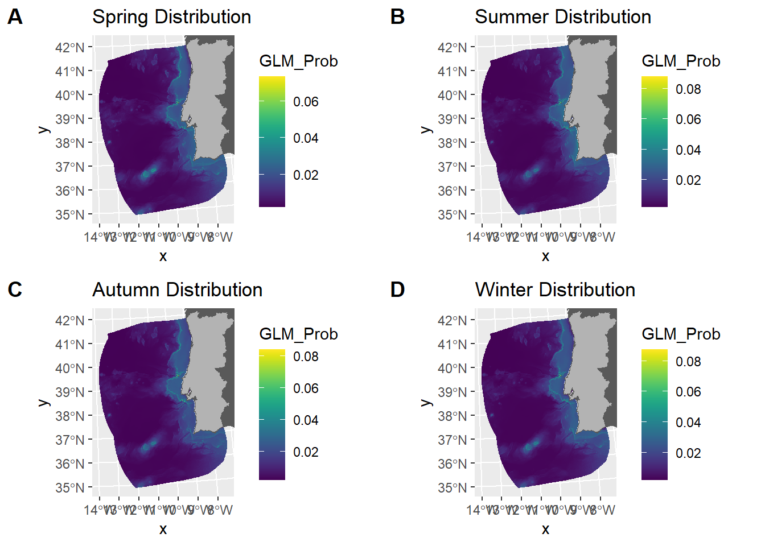
Mapping the other seasons Put them all together
Now we just need to repeat the code, but for each prediction grid separately.
We use the plot_grid function to put the maps all together.

Slide 23
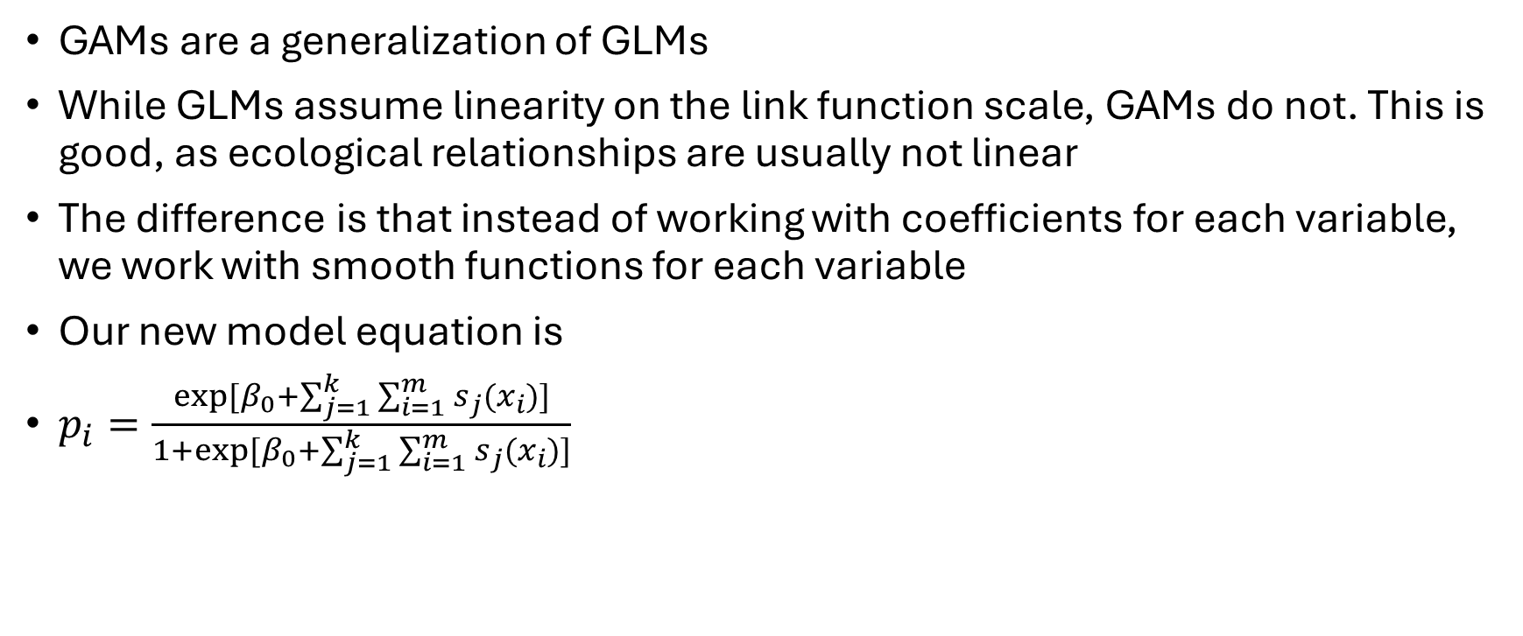
Trying a different model type Generalized Additive Models (GAMs)
GAMs are a generalization of GLMs
While GLMs assume linearity on the link function scale, GAMs do not. This is good, as ecological relationships are usually not linear
The difference is that instead of working with coefficients for each variable, we work with smooth functions for each variable
Our new model equation is
$p_{i}=\frac{exp⁡[β_{0}+\sum_{j=1}^{k}{\sum_{i=1}^{m}{s_{j}(x_{i})}}]}{1+exp⁡[β_{0}+\sum_{j=1}^{k}{\sum_{i=1}^{m}{s_{j}(x_{i})}}]}$

Slide 24
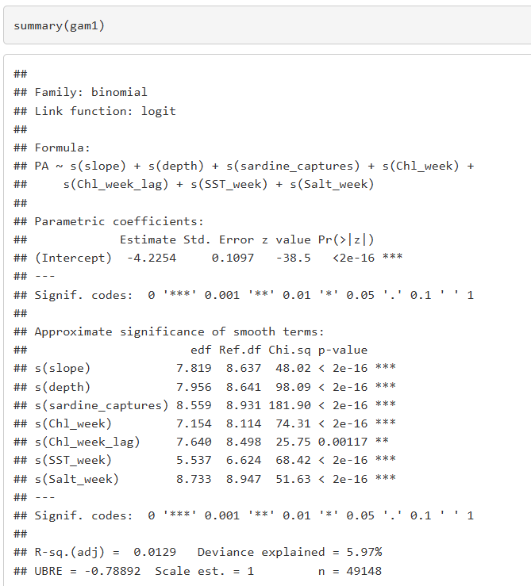
Miguel, STOP with the stats! Let’s go to the coding part
The code structure for GAMs is nearly identical to the GLM. The difference is that we need to specify we want smooth functions for our model. They are given by the s() function.
There are other types of functions you could use, but we leave that for your own studies.
Interpreting a GAM summary is very similar to a GLM as well. The difference lies in the coefficients or lack there of in the GAM output. Our interpretation of the relationships between the presence absence of the dolphin and the environmental variables is graphic.
Don’t be scared by the low Deviance explained (5.97%). This is very common in models where there are a lot more 0s than 1s in the data. It is to be expected and very hard to improve.

Slide 25
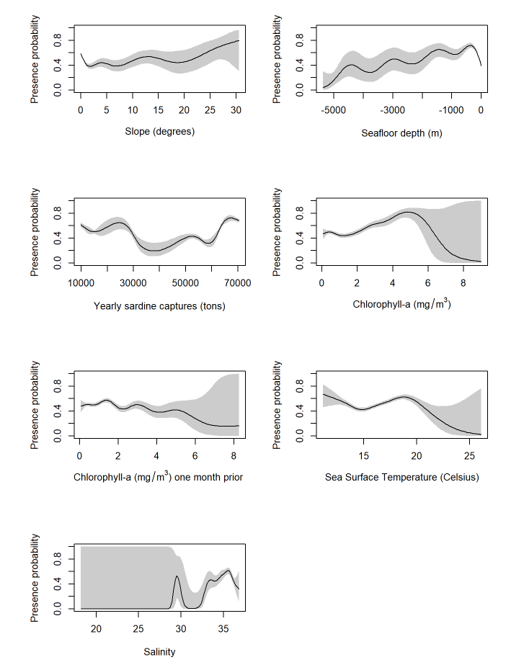
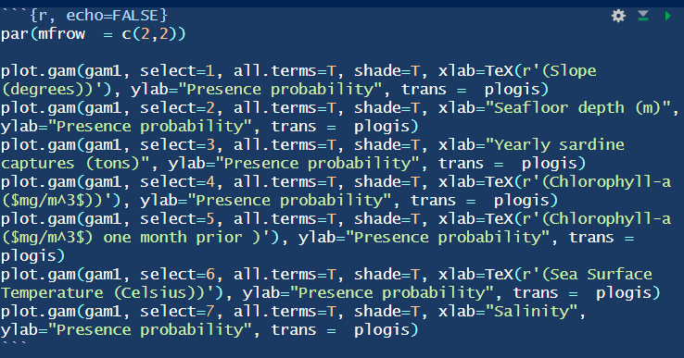
Plotting the response curves
By starting the code with par(mfrow = c(2,2)) we are telling R that we want the plots to be organized in a two-by-two format.
We use the plot.gam function to plot GAM response curves. We need to give it the name of the model we want the response curves of. The select argument is the number, in order of what we write in the formula, of the smooth function of the variable we want to plot. shade= T gives us an uncertainty measure of the response curve. xlab and ylab give the text we want to put in the respective axis. The trans argument sets the scale of the response curve, plogis is used for logistic models.

Slide 26
Changing the maximum degrees of freedom in smooth functions
The plots for our GAM are a bit wiggly
We can reduce this wigglyness
Reducing the k argument in the s() function
K gives the max degrees of freedom in a smooth
By default, the model assumes k = 10
Let’s reduce it to 4 for all variables

Slide 27
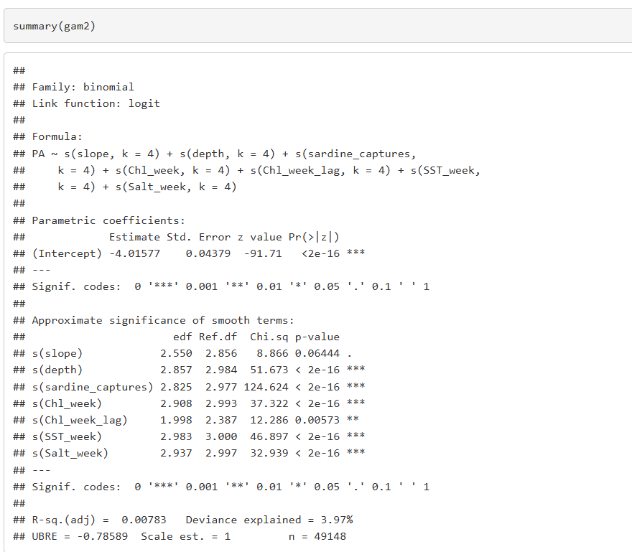
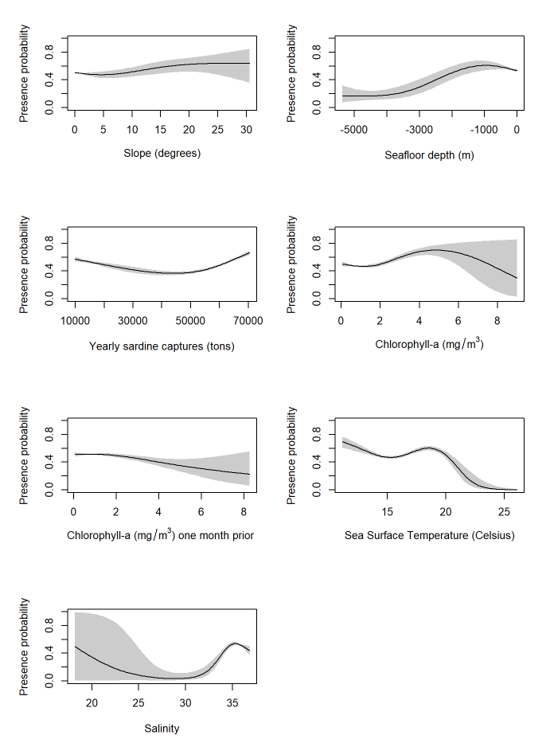
Changing the maximum degrees of freedom in smooth functions
You can essentially copy the code for gam1 and just add k=4 inside each smooth function.
The summary shows a lower deviance explained, which makes sense since we are restricting the model complexity.
To plot, use the same code as before, but change the model name from gam1 to gam2. Now the response curves seem much more reasonable.

Slide 28
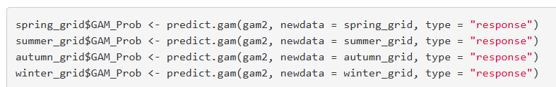
Predicting results
The logic for model prediction is the exact same as before, but instead of using predict.glm we use predict.gam since we are working with GAMs.
Let’s do this already for all seasons.

Slide 29
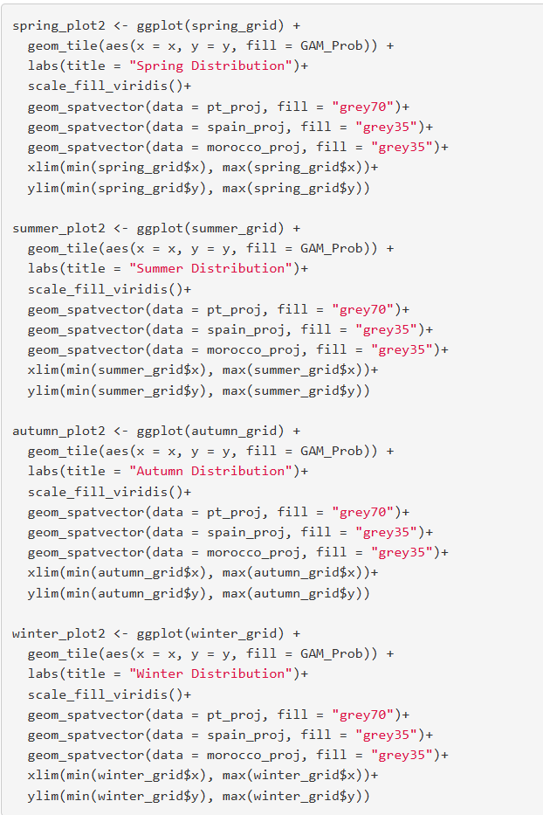
Mapping the results
You can copy the exact same code as before, but change the fill from GLM_Prob to GAM_Prob so that you are using the GAM predictions.
Do this for each prediction grid.
Then, using the plot_grid function, create the plot with the model predictions for presence probability in each season.

Slide 30
Final results
While the model still predicts a largely coastal distribution, it’s different from before. This shows how using different model algorithm's impacts the predictions.

Slide 31
Any final questions?

